Slide 1
2001 SAT Scores: Distribution Estimations
Swara Salih
Notes:
All graphs made using Seaborn.

Slide 2
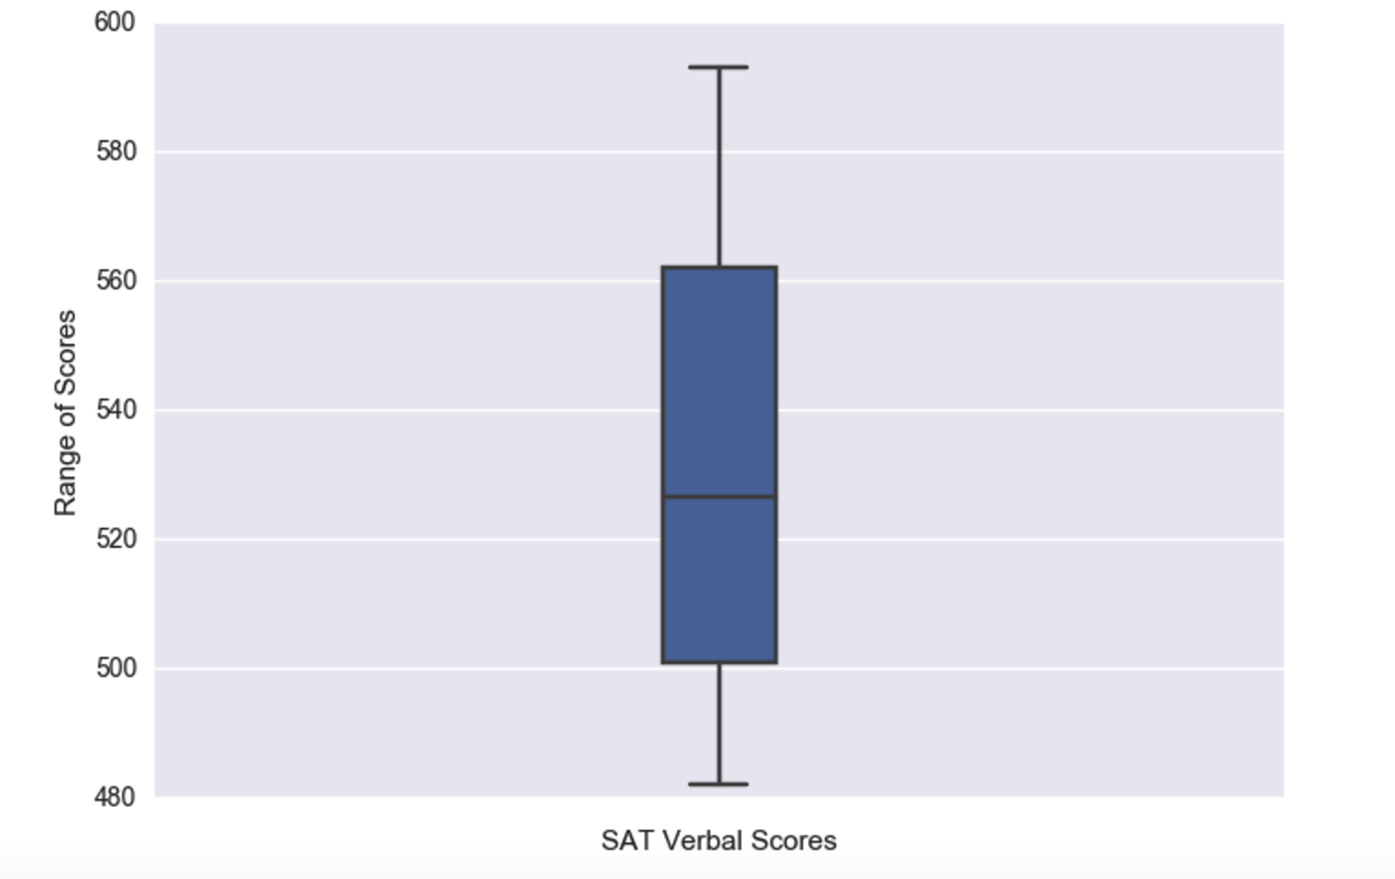
Range of Verbal Scores
Notes:
Recall the median verbal score is 526, the mean is 532, the max is 593, the min is 482,
and the std. deviation is 33.236.

Slide 3
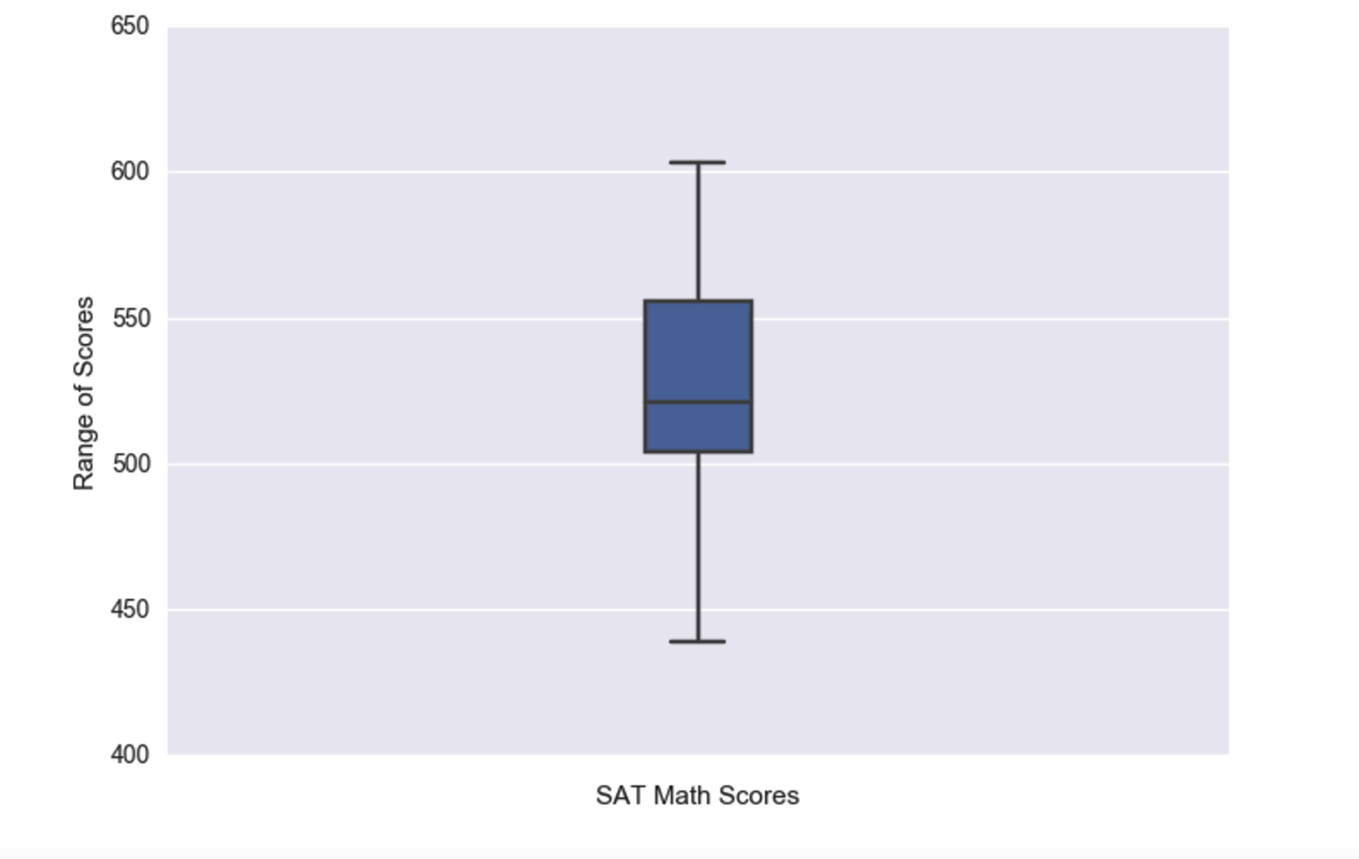
Range of Math Scores
Notes:
Recall the median math score is 521, the mean is 531.5, the max is 603, the min is 439,
# and the std. deviation is 33.236.

Slide 4
Overall data across US
Average verbal score: 532; observed median score: 526 in Oregon.
Average math score: 531; observed median score of 521, but not seen in dataset.
The lowest verbal score observed is 482 in D.C., and the highest is 593 in Iowa.
The minimum math score is 439 in Ohio; maximum is 603,, interestingly also in Iowa.
Iowa has the highest SAT Scores in the country overall.

Slide 5


Slide 6
Do the scores correlate?

Slide 7
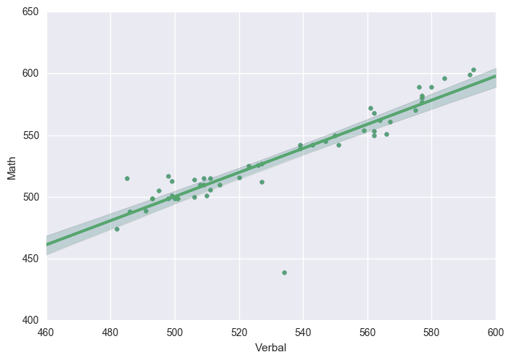

Slide 8
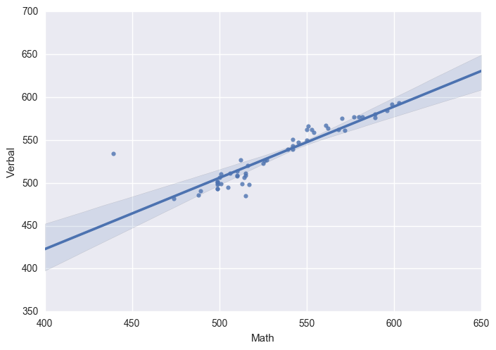

Slide 9
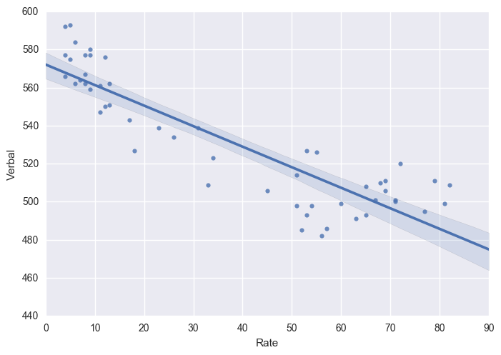

Slide 10
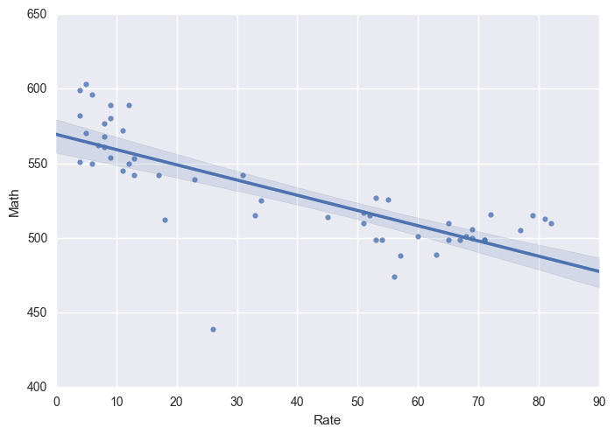

Slide 11
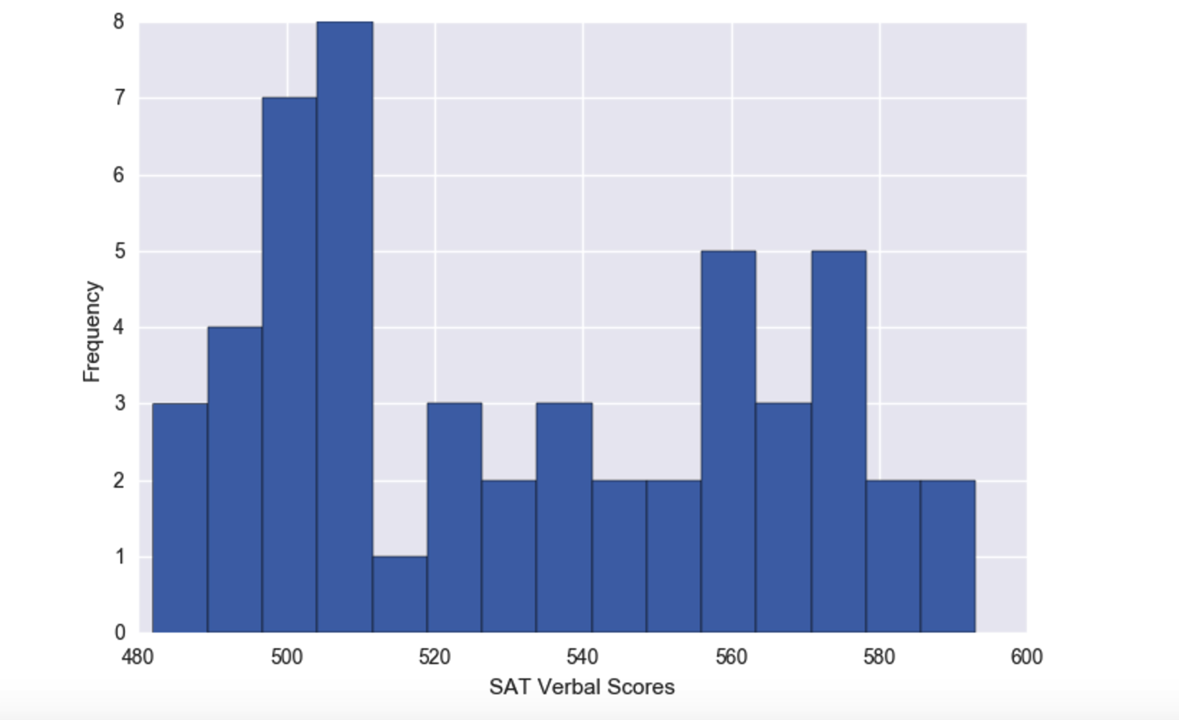
Distribution of Verbal Values
Notes:
Appears to be right/positively skewed

Slide 12
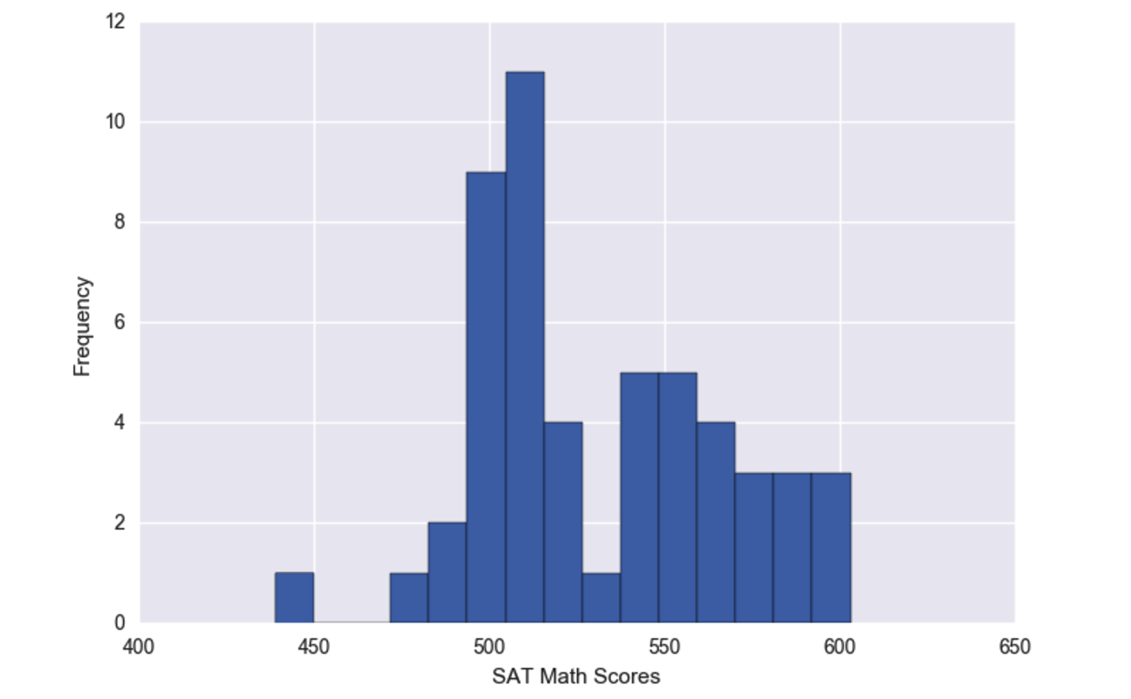
Distribution of Math Scores
Notes:
Also appears to be right/positively skewed.
How can we check for an actual smoothed out distribution?

Slide 13
Kernel Density Estimation (KDE)
A method for determining the dataset’s true distribution
KDE is an estimator that uses each data point to make an estimate of the distribution and attempts to fit it to the histogram
This resulting curve has an area below it equal to one, hence the decimal units for frequency.
Notes:
Equation for determining it https://wikimedia.org/api/rest_v1/media/math/render/svg/15255412d35488194b7e24e4518765e0af9992b5
Built into Seaborn

Slide 14

KDE contd.
Problems with histograms for visually determining distribution:
We need to consider the width and end points of our bins
Results in histograms not being smooth
To remove dependence on the end points of these bins, kernel estimators create a “kernel function” at each data point to create a “smooth density estimate”
Most crucially, KDEs smooth out the contribution of each data point in its surrounding area; below is how we determine this contribution:
Notes:
The disadvantages of histograms were the motivation for kernel estimators.
http://homepages.inf.ed.ac.uk/rbf/CVonline/LOCAL_COPIES/AV0405/MISHRA/kde.html
K is the kernel function, h its bandwidth (ask about this), and (x-x(i)) is the data point’s effect on other data points

Slide 15
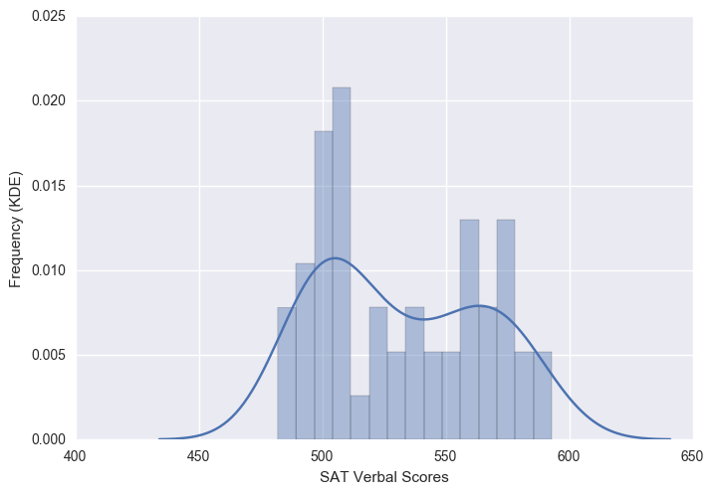

Slide 16
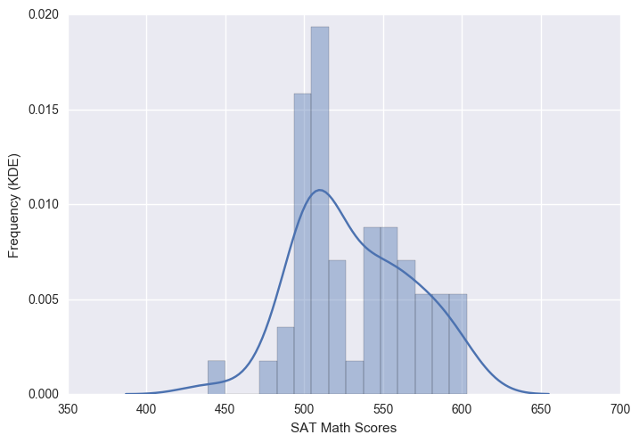
Notes:
As expected, both follow a right/positively skewed distribution.

Slide 17
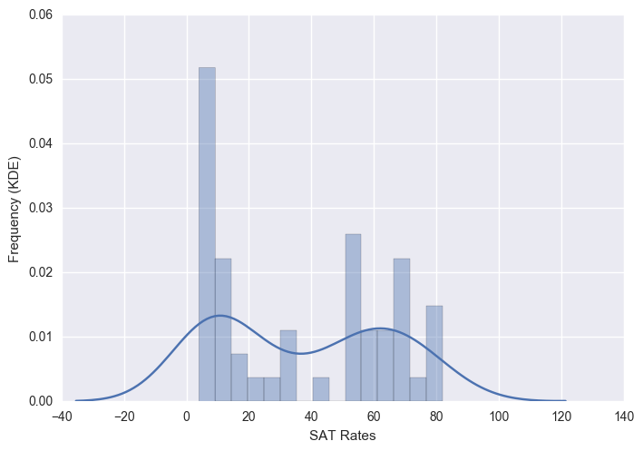

Slide 18
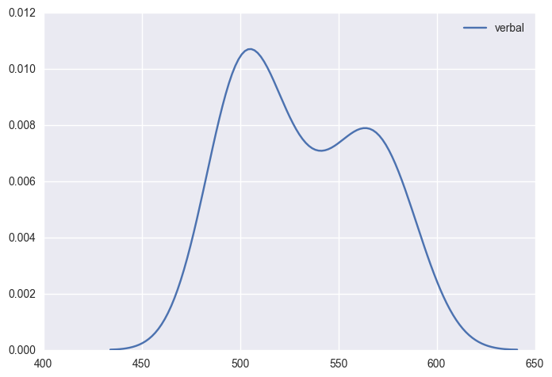
Notes:
sns.kdeplot(sat_scoresverbal)
plt.show()

Slide 19
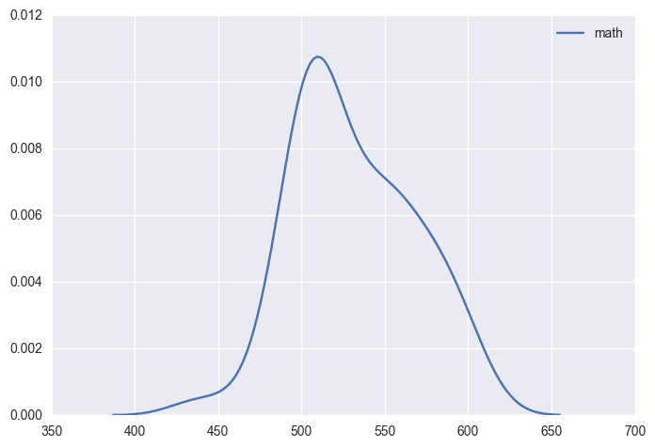

Slide 20
